Slide 1
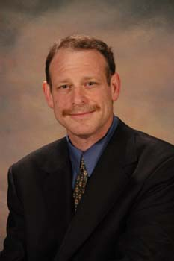

What Hollywood taught me about software testing.
Robert Sabourin
President & Principal consultant
AmiBug.Com, Inc.
Montreal, Canada
rsabourin@amibug.com

Slide 2
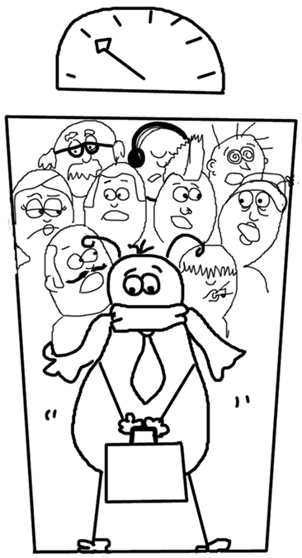
What Hollywood taught me about software testing.
Overview
  Learning and Metaphors
  Movie makers
  Movie genres
  Some lessons
  Limits of the metaphor

Slide 3
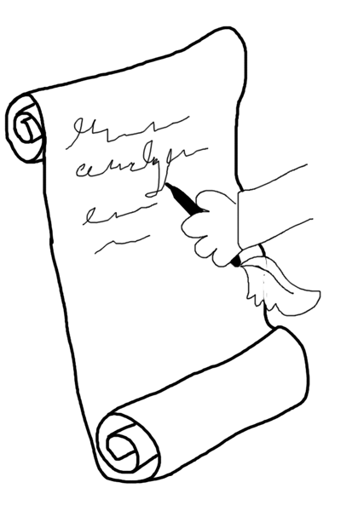
Learning and Metaphors
Teaching
Learning
Retaining
Applying knowledge
Share experiences
Don’t get carried away …

Slide 4
The Director
Director
Who does what?
When? How?
Get the most out of team members
Maps $$ to goals
Test lead?

Slide 5
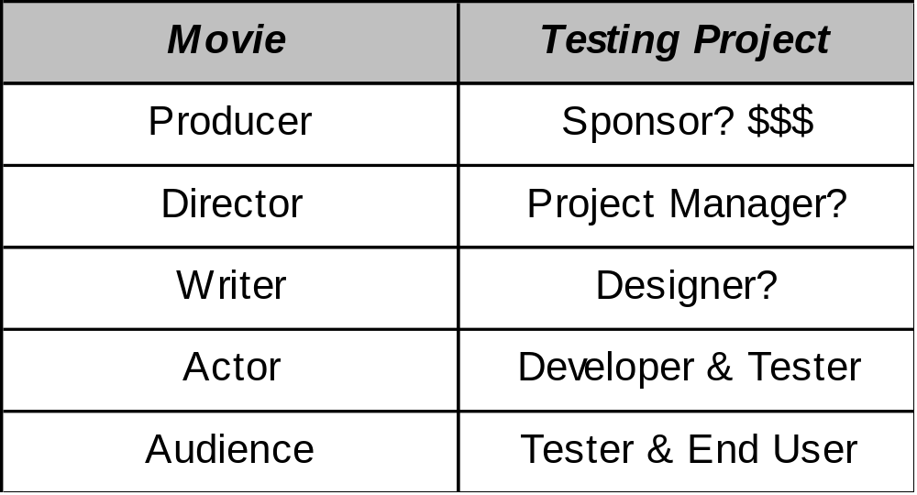
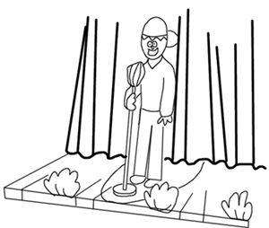
Getting things done

Slide 6
Clapboard
“Action”
Take 3, Scene 21
Role em
Get it right
Segment identifiers

Slide 7
Academy Awards
Best Tester
Best Tester in a supporting role
Best Picture
Best Short Subject
Best Screenplay
Best Director

Slide 8
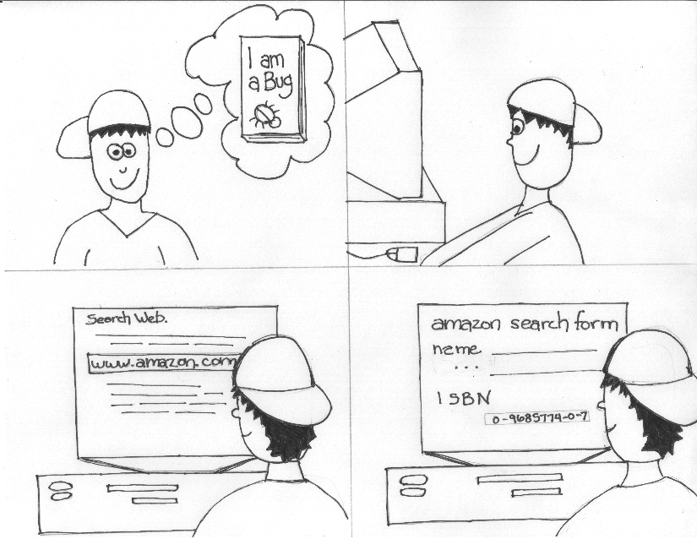
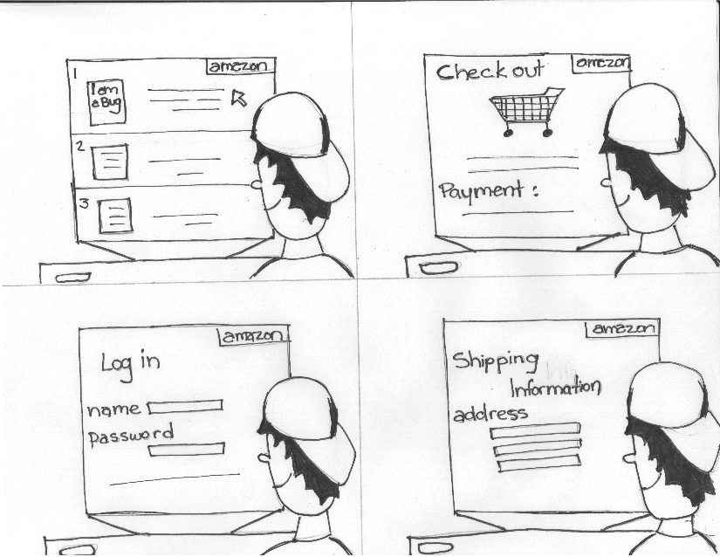
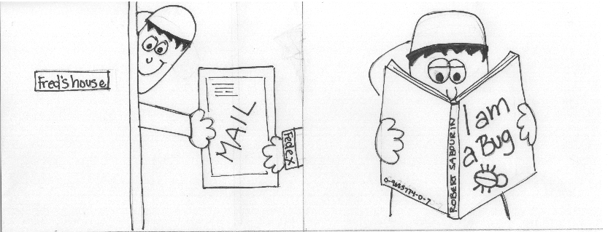
Story Boards

Slide 9
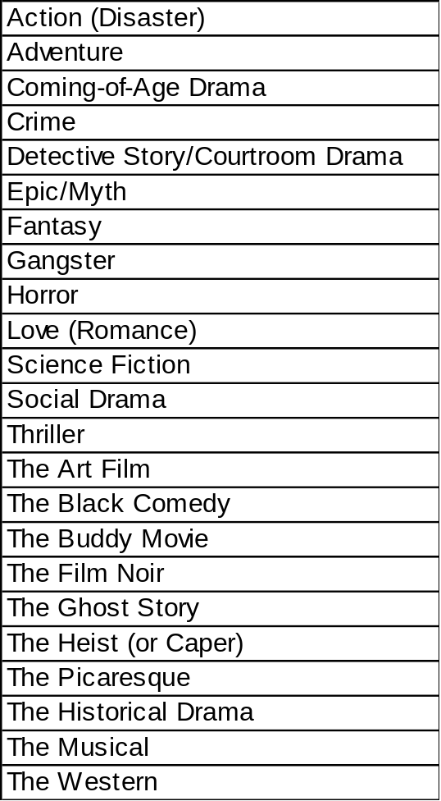
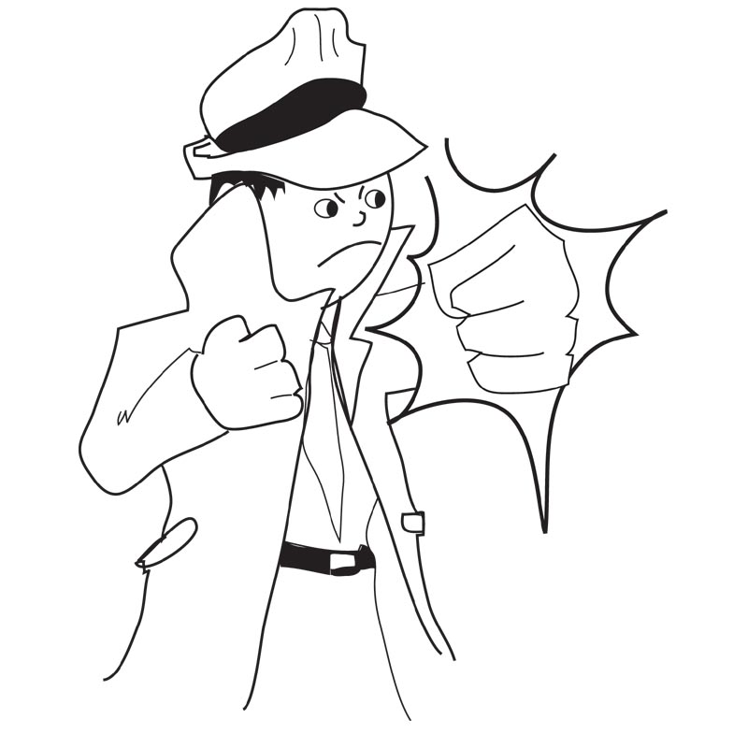
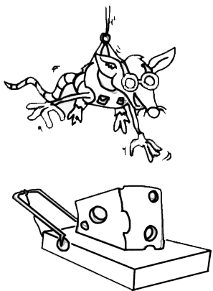
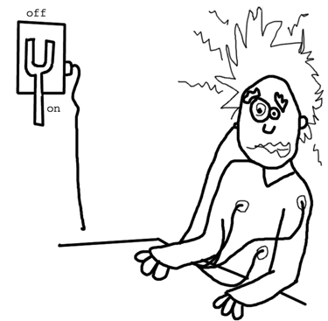
Genre

Slide 10
Apollo 13
Action Thriller
True Story
Happy ending
Against the odds
Project Roles
Value Simulation
Realistic constraints

Slide 11
Austin Powers
Bondish Parody
Behave!
Tactless
Absurd
No rules!

Slide 12
Casablanca
Romantic
Film noir
“Here’s looking at you”
“Play it again Sam”
Rick's Cafe Americain
Neutral zone safe harbor in project

Slide 13
Charlie Chaplin
Silent Comedy
Recurrent role
Humor in the commonplace
Little tramp
Slapstick
Banana peel

Slide 14
Forrest Gump
The Picaresque: An episodic string of adventures
“Life is like a box of chocolates”
“It happens”
“Run Forest Run!”

Slide 15
Friday the 13th
Jason returns
Sequels
Blood everywhere
Project from Hell
Typical day in the life

Slide 16
The Godfather
Offer you can’t refuse
Roles:Enzo the baker
“Every time I get out they pull me back in”
Family

Slide 17
Gone with the Wind
Frankly Scarlet I don’t give a damn
Survive with the resources in hand
Atlanta’s fate
Tara - be purposeful

Slide 18
Jurassic Park
Development on the live system!
Context?
Rainy day testing
Pesimal
Failure modes

Slide 19
Lion King
Acuna Matta - “no worry's for the
rest of your days”
Status report bird
Easily distracted
Coming of age

Slide 20
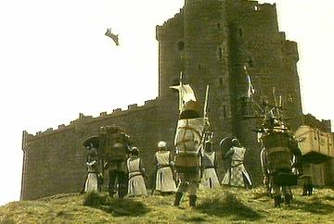
Monty Python and the Holy Grail
Throw it over the wall
Grail the illusive goal
Knights who say “ni”
Shrubs specified

Slide 21
Saturday Night Fever
Staying Alive
Anyone can learn to Dance, but can they learn to act too?
Will disco ever really be dead?

Slide 22
Silence of the Lambs
Elicitation and the art of interviewing
Too much analysis
Patterns
Gag orders
Overconfidence

Slide 23
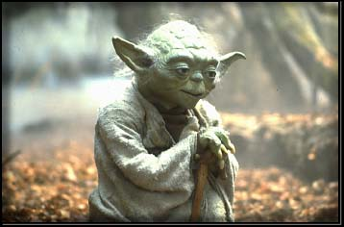
Star Wars
Project on track
"No! Try not, Do. Or do not. There is no try."
Many Bothans have died …
Retrospective

Slide 24
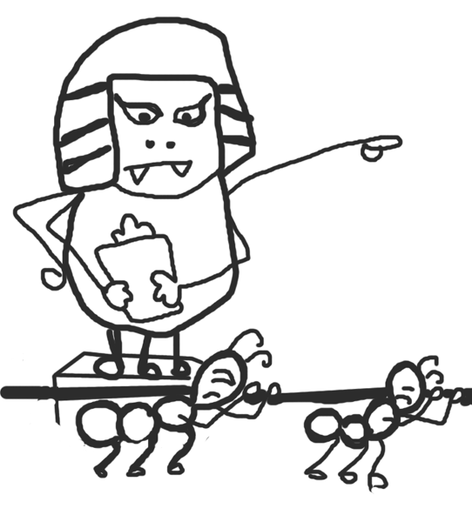
Ten Commandments
Teamwork
Persistence
Relationships with executive stakeholders
Divide and conquer

Slide 25
Terminator
I’ll be back ...
Machines vs. Man
Bad guy becomes a good guy

Slide 26
Three Stooges
Funny - real?
Outrageous
Roles
Development Lead, Product Manager, Test Lead

Slide 27
The Titanic
What are you willing to sacrifice
Unsinkable
Fun to be in front
Dangers lurking ...

Slide 28
Western
Survival in wild times
“Howdy Partner”
Clear roles
Stagecoach risks
Clean up manure

Slide 29
The Wizard of OZ
Off to see the Wizard
No Place Like Home
Yellow Brick Road
Wizard will solve all our problems

Slide 30
“Metaphors are limited”
Testing Projects | Hollywood Movies
The never ending story ...
Generally timeboxed ...
The tester is the unsung hero ...
Credits longer than the film ...
Repeating mistakes - screw ups ...
Sequels ...

Slide 31
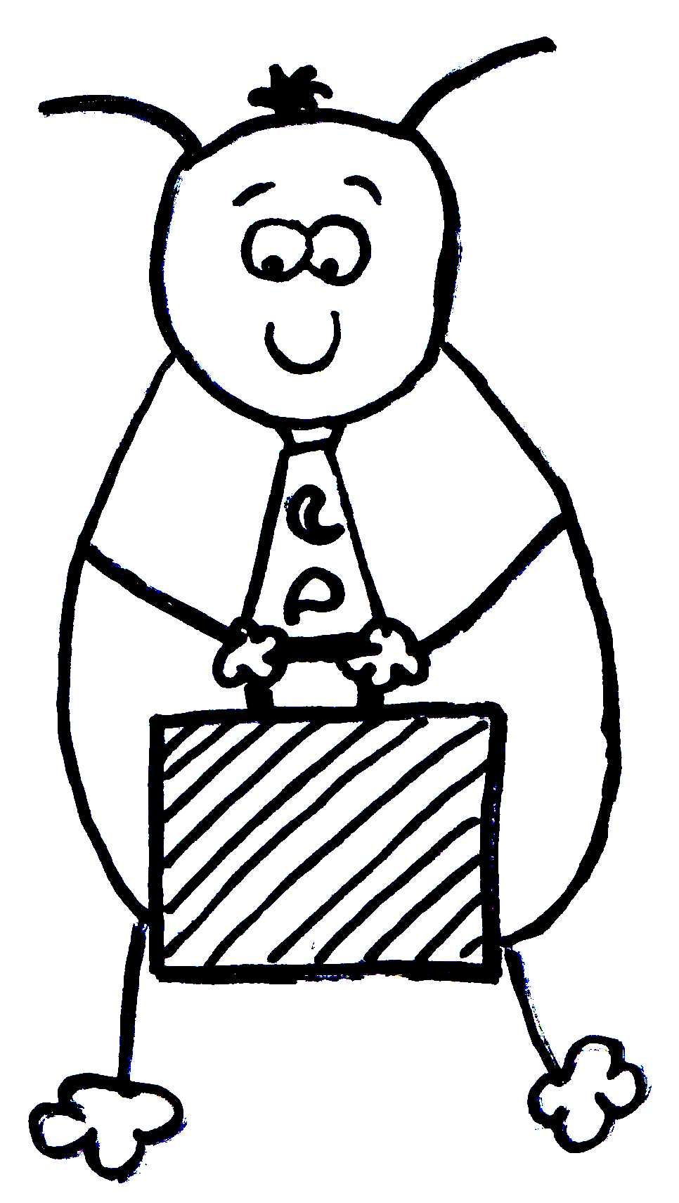
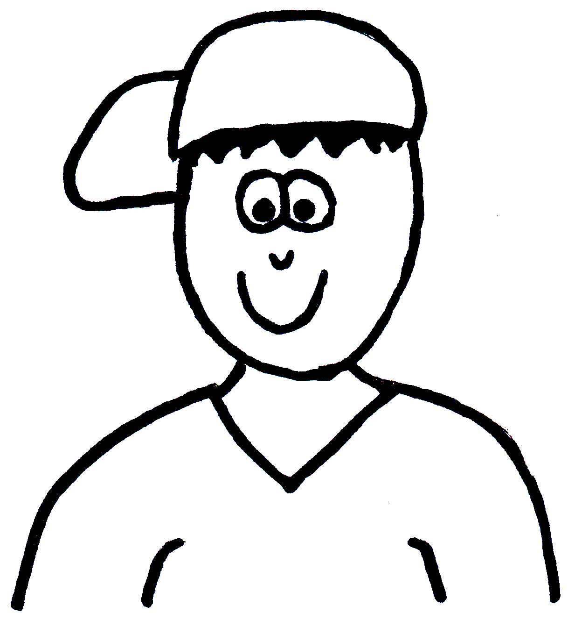
Thank You
Questions?

